Slide 1
Transverse Loading
Shear Stress Calculation Error
Shear Stress in Thin Walled Sections
Shear Flow

Slide 2
Shear Stress Error
b=4h
h
h
P
P
NA
b=0.5h

Slide 3
Error in Circular Beams

Slide 4
Beam Loading
L/2
L

Slide 5
Shear Stress in Thin Walled Sections
NA

Slide 6
Equilibrium of SubSections of the Beam are Considered

Slide 7
Equilibrium in Flange
s
t_{f}

Slide 8
Equilibrium in Web
s
t_{w}

Slide 9
Shear Stress Result
NA

Slide 10
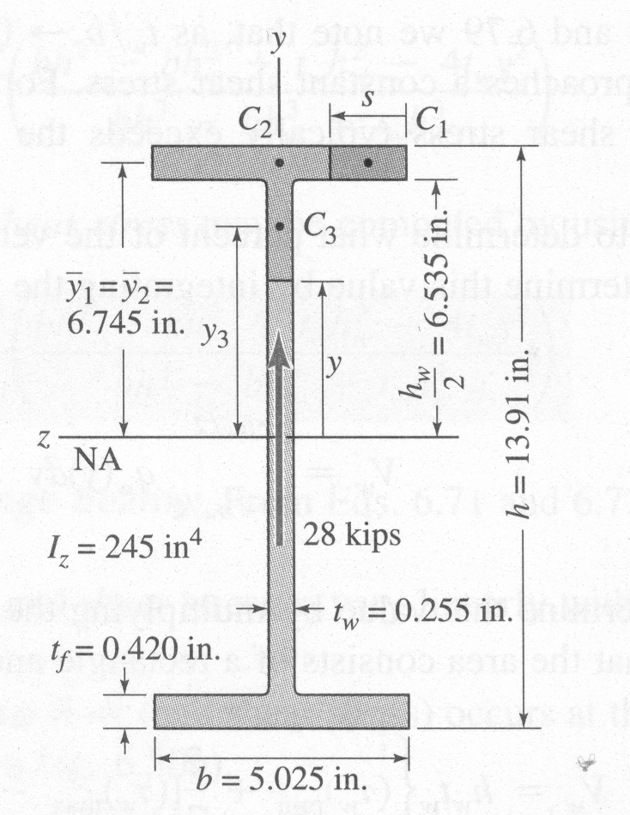
Example

Slide 11
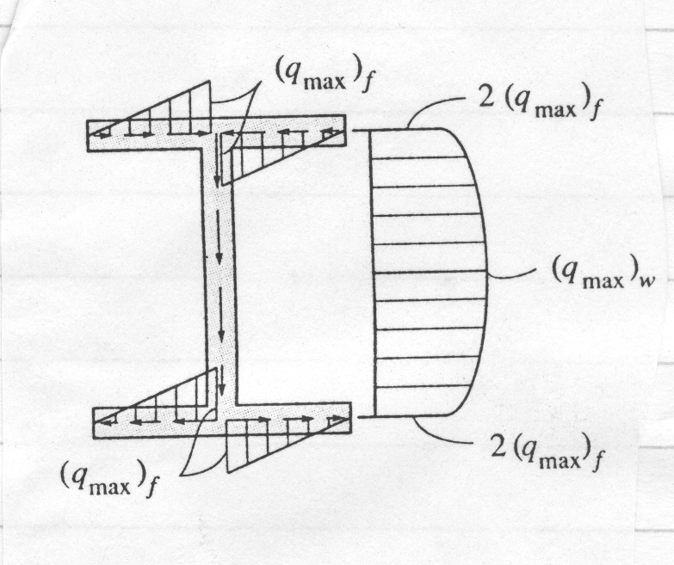
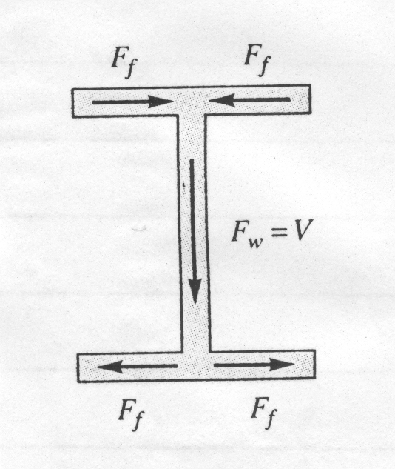
Shear Stress Distribution

Slide 12
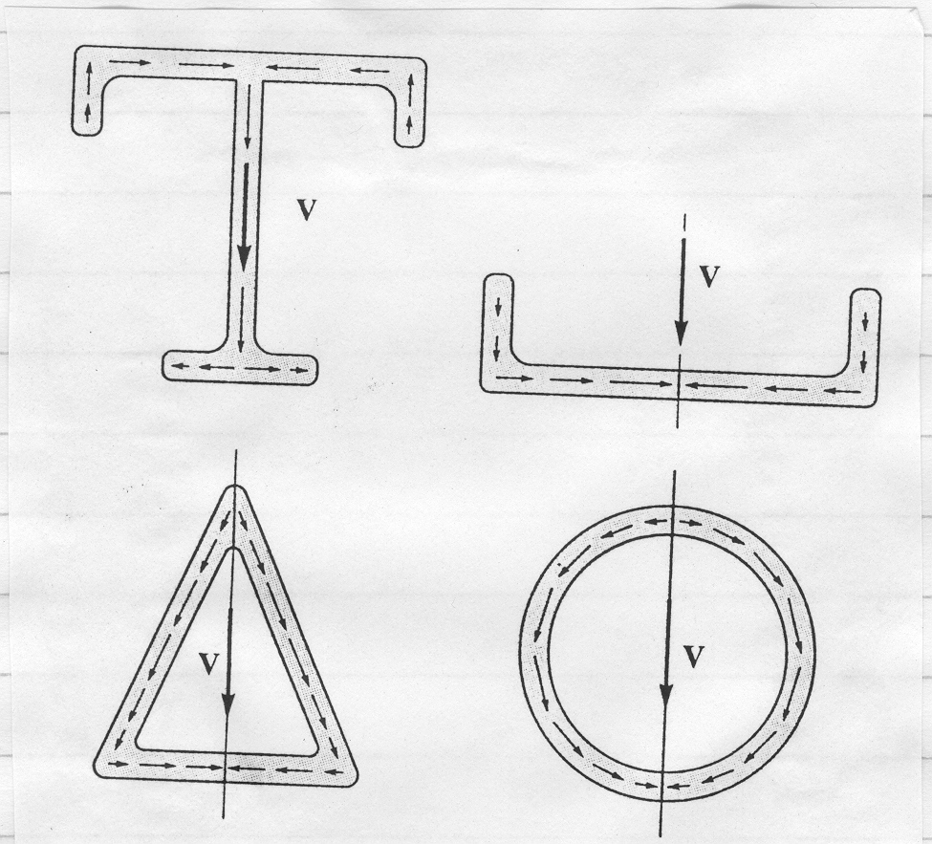
Shear Stress Distributions

Slide 13
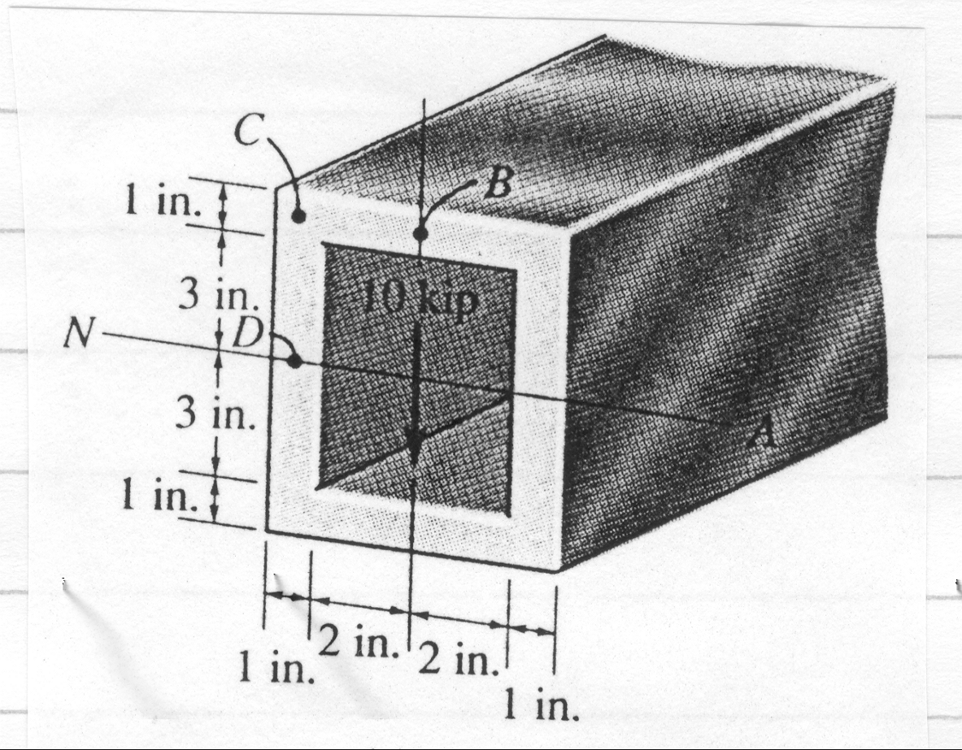
Example

Slide 14
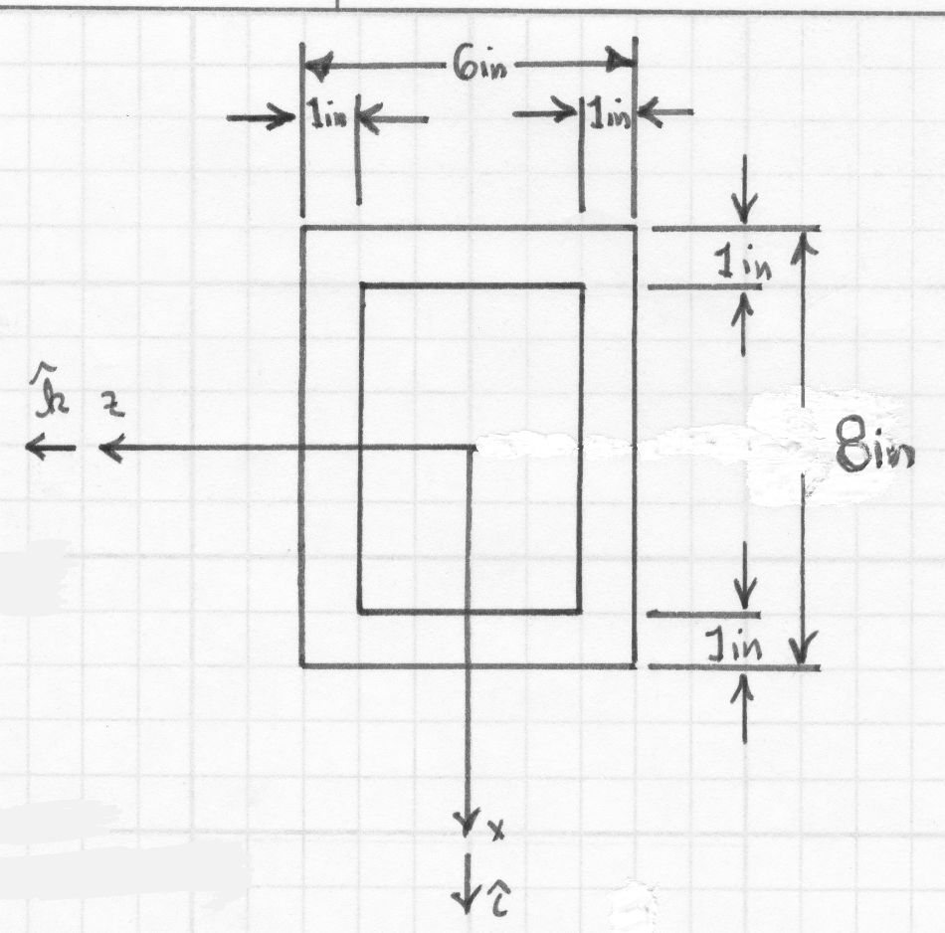
Cross-Sectional Geometry

Slide 15
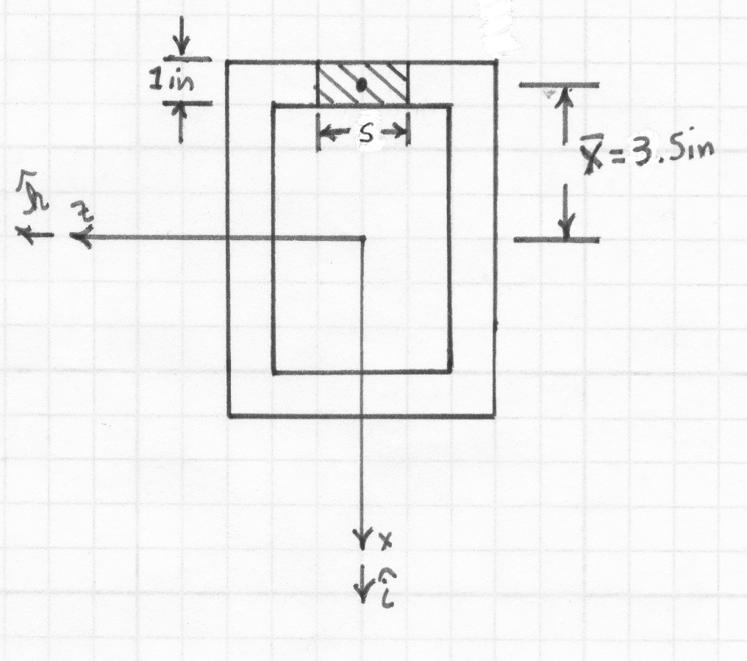
Distribution in Top Section

Slide 16
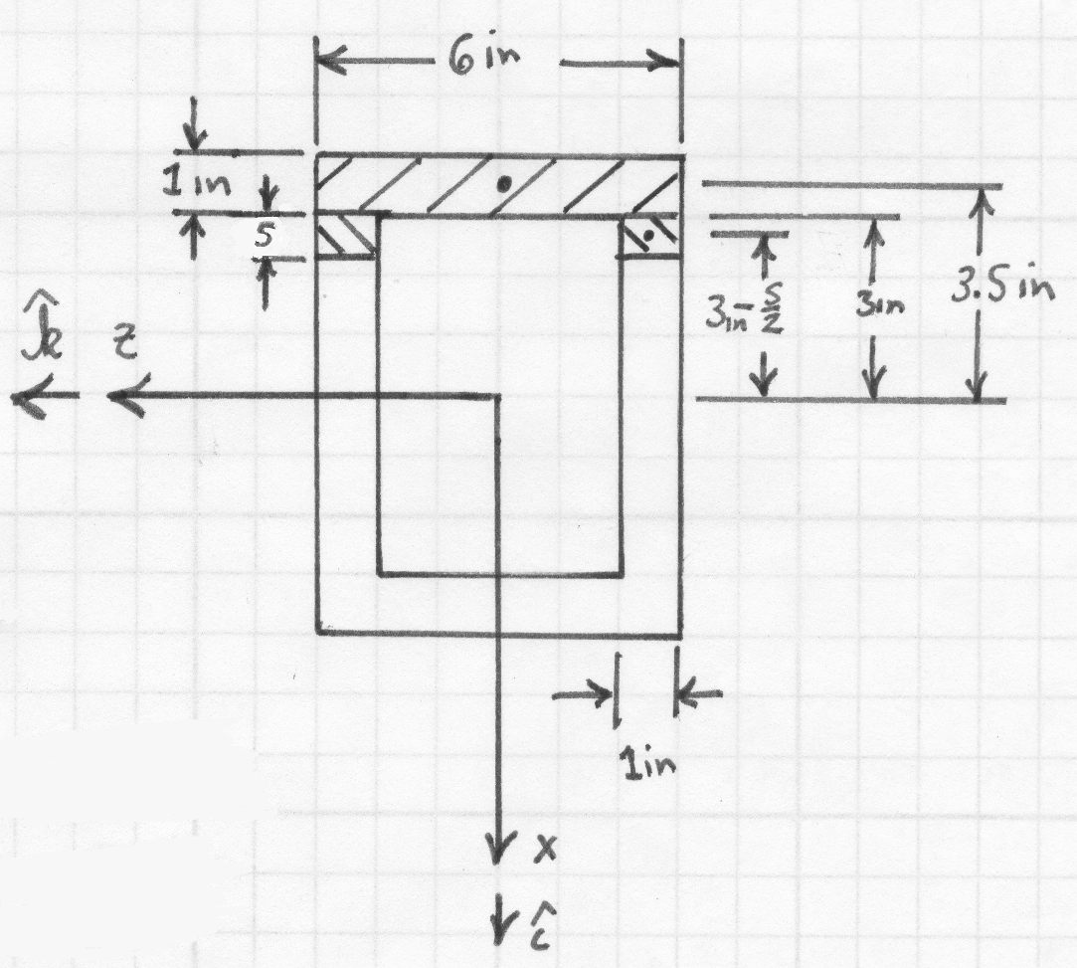
Distribution in Side Sections

Slide 17
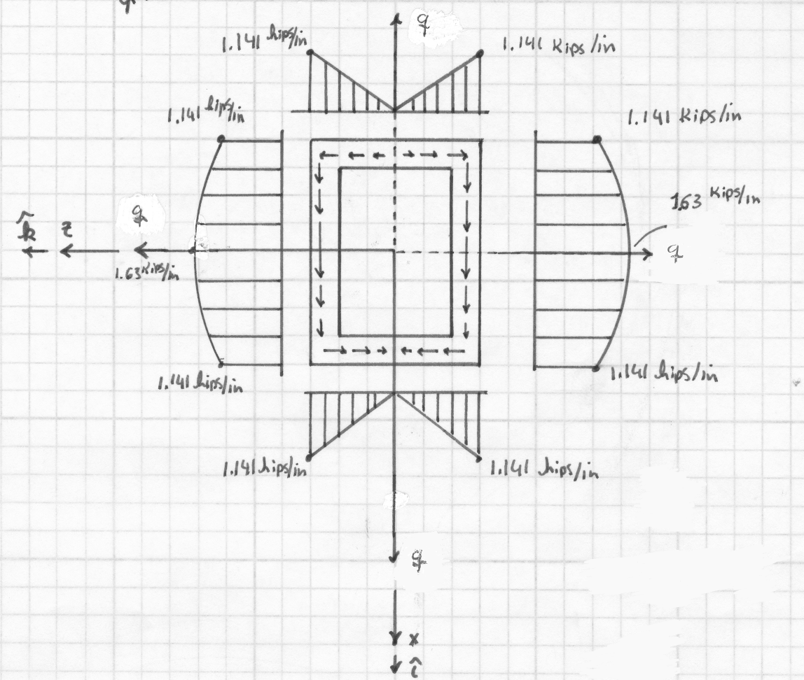
Shear Flow

Slide 18
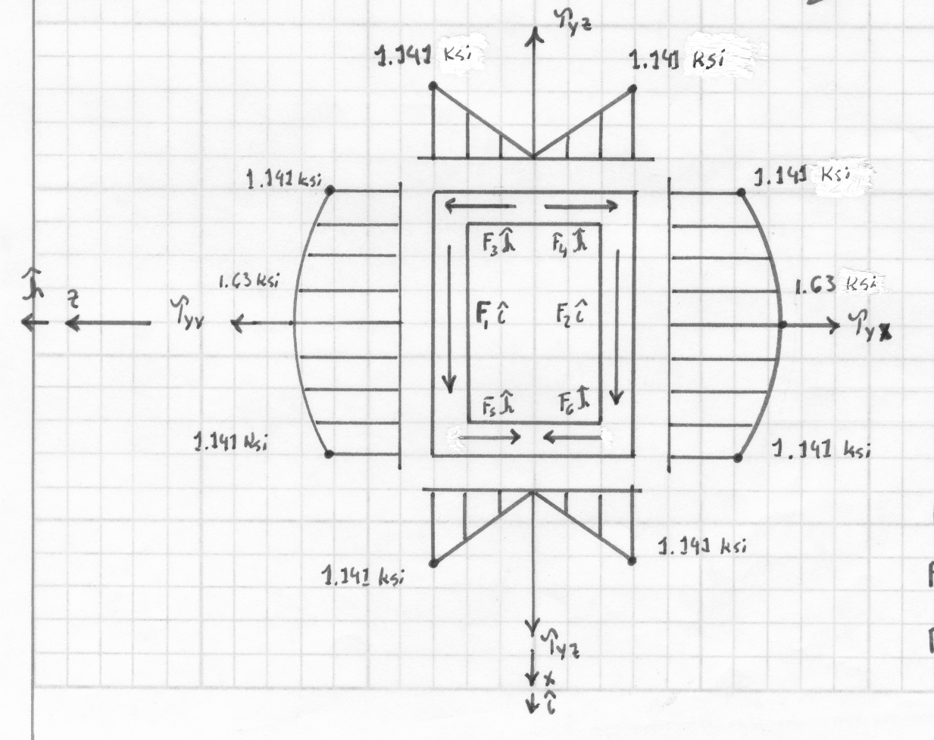
Shear Stress

Slide 19
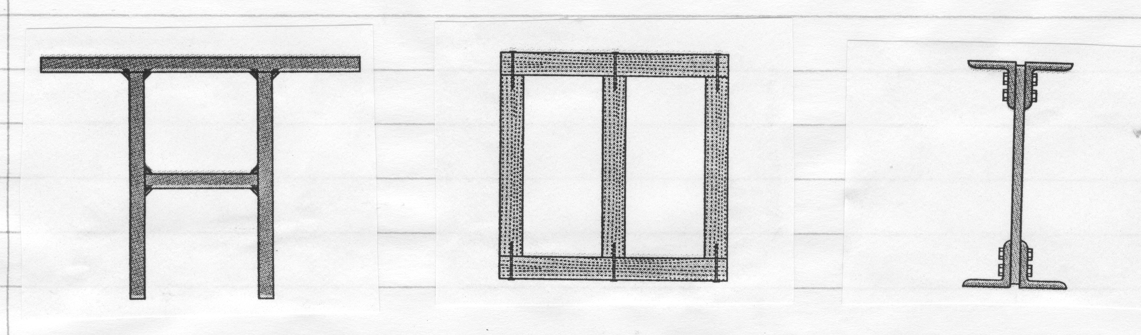
Built Up Beams

Slide 20
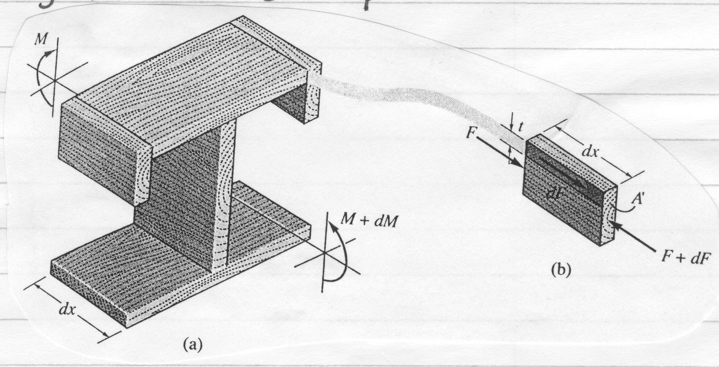
Load at Intersection

Slide 21
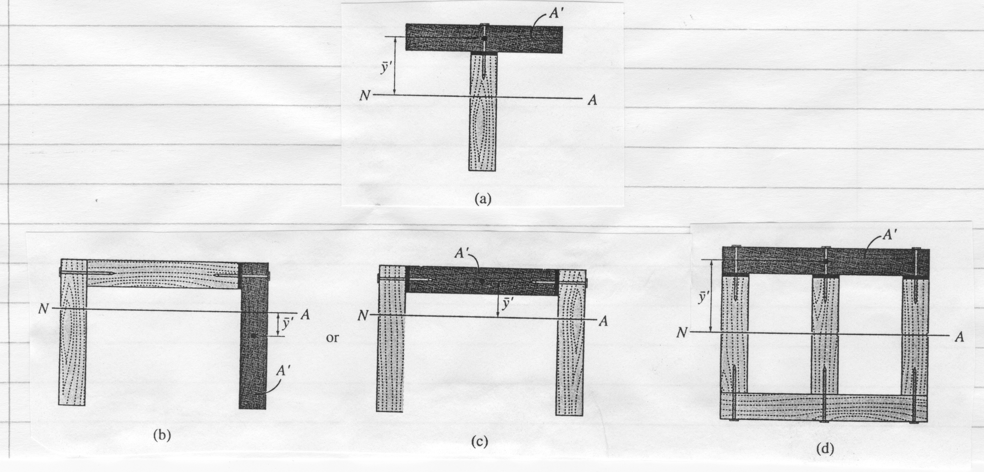
Different Configurations

Slide 22
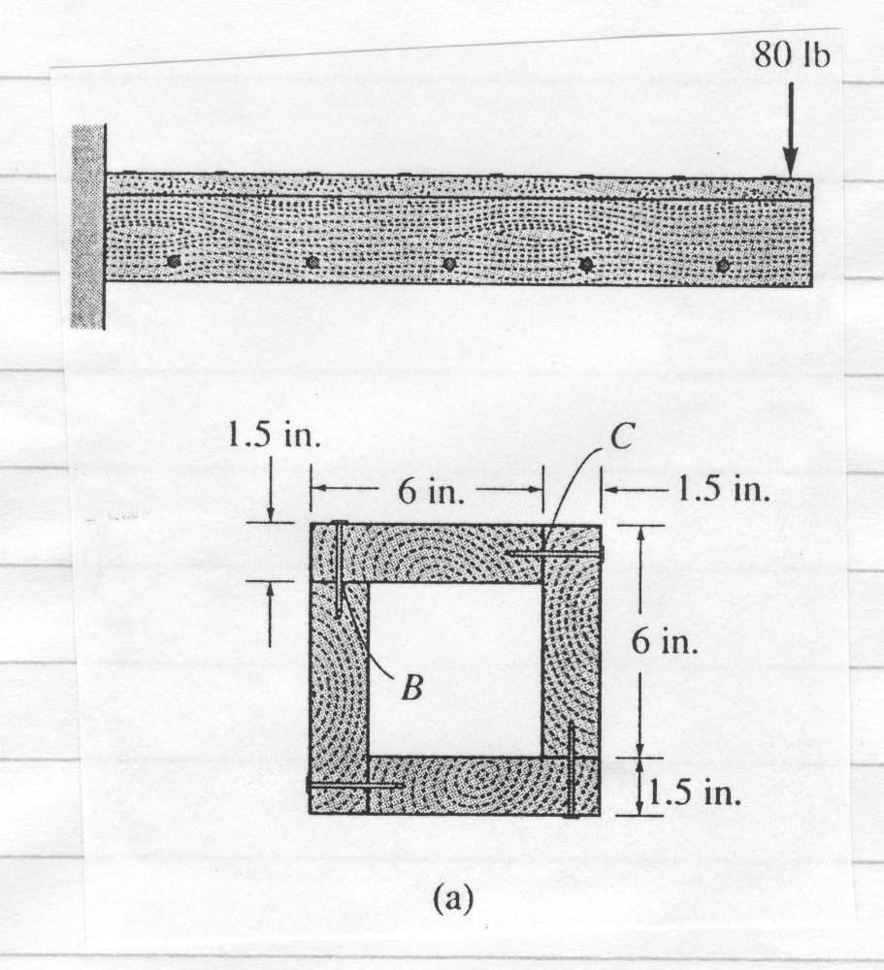
Example
A box beam is to be constructed from four boards nailed together as shown. If each nail can support a shear force of 30lb, determine the maximum spacing s of nails at B and C so that the beam will support a vertical force of 80lbs.

